Slide 1
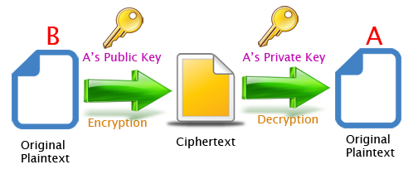
Activity 2.1.5
Encrypting and Decrypting with Paired Keys
Image Credit: www.giuseppeurso.eu

Slide 2
Create a Pair of Keys
Open paired_keys.py in Canopy
Run the file
Call the make_keys() function to assign public and private keys
Check your public_key and private_key
Share your public_key with someone who will send you a message
In [1]: private_key, public_key = make_keys()
In [2]: private_key
Out[2]: (37399, 227)
In [3]: public_key
Out[3]: (37399, 163)

Slide 3
Numerize a Message
Store a message in a variable
Call the numerize() function on the message, storing it as a new variable
In [4]: message = 'This is my message.'
In [5]: number_message = numerize(message)
In [6]: number_message
Out[6]: '0658-7879-8906-7989-0683-9506-8375-8989-7177-7520'

Slide 4
Encrypt and Send a Message
Get the recipient’s public_key and store it as a variable
Encrypt the message by calling the use_key() function on the number_message with the recipient’s public_key, storing it as a new variable
Display the encrypted message and give it to the recipient
In [7]: alans_key = (51983, 401)
In [8]: encrypted_message = use_key(alans_key, number_message)
In [9]: encrypted_message
Out[9]: '21078-9214-26168-49224-47190-12863-17967-0071-31472-19012'

Slide 5
Decrypt a Received Message
Receive a message that has been encrypted using your public_key
Store the encrypted message in a variable
Decrypt the message by calling the use_key() function on the received message using your private_key, storing it as variable
Denumerize the message that you unencrypted
In [10]: encrypted_message_to_me = '26897-10039-30618-20154-16024-21294-25577'
In [11]: unencrypted_message_to_me = use_key(private_key, encrypted_message_to_me)
In [12]: denumerize(unencrypted_message_to_me)
Out[12]: 'Hello, friend!'

